Slide 1
Introduction to Clinically Relevant Microbiology
Edward L. Goodman, MD
Core Faculty
Emeritus Chief of ID, Emeritus Medical Director of Infection Prevention and Antibiotic Stewardship
July 2, 2020

Slide 2
Outline
Major Groups of Bacteria Encountered
An Overview of What the Micro Lab Does
Newer Technology
A Few “Pearls”
A Primer on Susceptibility Testing
Review of some resistance mechanisms
Summary of “Everything You Wanted to Know about Antibiotics…”

Slide 4
Gram Positive Pathogens: staphylococci
Staphylococcus aureus (includes OSSA and MRSA)
Hints about detecting
On gram stain: GPC in clusters
Coagulase positive = Staph aureus
Grow rapidly in blood cultures (<12 hours)
99% beta lactamase producing = penicillin resistant
MRSA 52%
When considering S aureus as a pathogen, must cover MRSA until ruled out
Staphylococcus epidermidis and other coag negative staph
Usually “heteroresistant” = methicillin resistant
But if lab shows “oxacillin sensitive,” believe it (and stop vanc!)

Slide 5
Streptococci
Beta hemolytic
“Always” penicillin and cephalosporin sensitive
After 70+ years, still no resistance to penicillin G
Aggressive just like S aureus
Necrotizing Group A Strept/Toxic Shock require anti-toxin therapy as well
Clindamycin or linezolid are drugs that affect protein synthesis; toxins are proteins
Viridans
Almost always sensitive to Ceftriaxone. Penicillin sensitivity variable

Slide 6
Enterococcus
Inhibited but not killed by beta lactam monotherapy
For endocarditis, require “bactericidal” therapy
Penicillin or ampicillin plus aminoglycoside
Alternative penicillin or ampicillin plus ceftriaxone
For non endocarditis, does not require ‘cidal therapy, so no need for combined therapy
VRE uncommon (8% of E faecium)
Choices include ampicillin for E faecalis, linezolid, daptomycin
Still requires “contact precautions” during and after active infection since GI colonization cannot be eradicated

Slide 7
Aerobic Gram Negative Rods
Enterobacteriaceae: E coli, Klebsiella, Proteus, Serratia, Shigella, Salmonella, Citrobacter
Grow aerobically and anaerobically
Can grow in anaerobic as well as aerobic blood culture bottle
Increasing mechanisms of resistance (more later)
Non fermenters: Pseudomonas, Acinetobacter
Inherently drug resistant and increasing acquired resistance
Only grow in aerobic blood culture bottle
Opportunistic pathogens
Often require combination empiric therapy until susceptibility proven
No evidence that double coverage protects against emergence of resistance

Slide 8
Anaerobes: think of when dealing with infections coming from or adjacent to mucosal surfaces
Gram negative: Bacteroides, fusobacteria
Normal distal gut and vaginal flora
Usually beta lactamase producing
Usually part of mixed flora
Distinct gram stain appearance and putrid odor
Proteus also have a distinct odor (H2S)
Gram positive: peptococci/strept and clostridia
Normal oral pharyngeal flora
Not beta lactamase producing = penicillin Rx effective
More aero-tolerant and less susceptible to metronidazole

Slide 9
What Does the Micro Lab Do?
Bacteriology
Blood
Urine
Respiratory
Stool
Wounds
Sterile body fluids
Tissue
Serology
Molecular (formerly viral)

Slide 10
Mycobacteria
Typical = M. tuberculosis
AFB smear from sputum = place patient in Airborne Precautions
Send three smears at 8 hour intervals, with one in early AM
If all three negative, Infection Prevention may allow Airborne Precautions to cease
Always check with IP before stopping Airborne
Direct PCR on sputum available for M. Tb as well as INH, Rif resistance (Cepheid)
Geneprobe on culture allows distinction between M. Tb and Avium, Kansasii

Slide 11
Atypical Mycobacteria
Slow growers
M. avium
Mimics TB
Disseminated in HIV
M. kansasii
Mimics TB
M. marinum
Aquarium, extremities, grows at lower temperature
Rapid growers = resistant to standard TB drugs
M. fortuitum
M. chelonei
M. abscessus

Slide 12
Mycology
Yeasts
Candida
Cryptococcus
Sporotrichosis
Hyphae formers
Dimorphic = geographic distribution
Histo, Cocci, Blasto
Opportunistic
Aspergillis
Zygomycetes
Fusarium

Slide 13
Parasitology
Protozoans (do not cause eosinophilia)
Malaria = rapid antigen test, thick and thin smears
Amoeba = rapid antigen test, serology
Giardia = rapid antigen test
Leishmania = histopathology
Worms = detected by microscopy (eggs and segments)
Roundworms (Ascaris, Strongyloides, Necator, pinworms)
Flukes (Schistosomiasis, Fasciola)
Tapeworms (Taenia)

Slide 14
Virology
No longer culture technology, only PCR and serology
Biofire Respiratory panel
16 viruses, 3 bacteria
Several corona viruses detected but not yet COVID (soon we hope)
Stool panel = restricted to ID and GI
CSF panel = restricted to ID
EBV
CMV
HSV
JK
Community acquired enterovirus panel not in use yet

Slide 15
Unique Features of Microbiology Lab
Susceptibility tests often lead directly to treatment
No other lab has that influence
Imagine a report that says:
“K is 3.0. Treat with 40 meq KCL!”
“Hgb 6.7. Treat with 2 u packed RBC”
But a urine culture growing 100,000 CFU of E coli susceptible to levofloxacin almost always leads to an order!! Just like Dr. Strangelove’s mechanical arm.

Slide 16
Technology in Micro
Automated blood culture detection = 24/7 positive results called to patient’s nurse
Rapid susceptibility testing
For most common organisms, MIC is resulted in 18 hours after growth on solid media
Molecular detection of resistance genes is available 4 hours from detection in liquid media – look for it in EMR or call
On gram positive, can detect S. aureus, Coag neg staph and Mec A (=MRSA.)
Report that states “Staph species” does not mean necessarily coag neg. It still could be S. aureus.
Gram negative = many enterobacteriaceae species, some ESBL targets. Not detecting an ESBL does not rule ESBL out. Have to wait on MICs
Nucleic acid amplification: N. gonorrhea, C. trachomatis on voided urine, as well as penile or cervical discharge
DNA probe for Mycobacteria tuberculosis
Fluorescent In Situ Hybridization (FISH): examples
MALDI-TOF = Mass spectrometry time of flight: examples

Slide 17
Some “Pearls”
Swabs only for throat; cervical and urethral swabs require special GC media
For abscesses, NEVER SEND SWAB. Instead promptly send liquid pus in capped syringe
Gram stain showing GNR but no aerobic growth, think of anaerobes
Anaerobic cultures only from abscesses, blood, tissue
Never from sputum, stool, urine, genital, CSF (OR YOU WILL BE LAUGHTED AT!)
Why? These sites have a normal anaerobic flora
Blood culture for GPC positive within <12 hours = likely S. aureus
Growth in anaerobic bottle could be enterobacteraciae (E coli, etc) or anaerobes, although anaerobes grow slower than aerobes
Growth in aerobic bottle could be enterobacteraciae or non fermenters (Pseudomonas, Acinetobacter)

Slide 18
More Pearls
Nucleic Acid Amplification Tests (NAAT) for gonorrhea and chlamydia are for:
Men: voided urine, pharynx, anus
Women: voided urine, pharynx, endocervix, anus
Do not allow susceptibilities, only detection of DNA
Neisseria gonorrhea is very fastidious, requiring X and V factors present in chocolate agar. Cultures are discouraged, but:
For sterile body fluid (joints, CSF) chocolate agar can grow N. gonorrhea and everything else
For mucosal sites (pharynx, cervix, rectum, urethra), chocolate agar grows EVERYTHING so must use Selective Inhibitory Agar (Jembec plates- Thayer Martin with Vanc, Colistin, Nystatin) with CO2 tablet. Then sealed in a bag
Call Micro Lab (X6350) for the appropriate media
Whenever a culture for gonorrhea is sent, IT MUST BE IMMEDIATELY TAKEN TO LAB or isolates will die

Slide 19
Susceptibility Testing
For aerobic/facultative bacteria only
For anaerobes, fungi, mycobacteria, it is a “send out”
Cascade reporting is a requirement for Antibiotic Stewardship
Reporting broad spectrum drugs only when there is resistance to narrow spectrum drugs
Suppressing drugs
If inappropriate for the site –e.g., nitrofurantoin for E coli in blood
If not in the formulary
So, if you are using a drug that is not in the susceptibility panel, there is a reason – no need to call Micro to test it or release result.

Slide 20
How Does a Patient Differ from a Test Tube?
Patient | Lab Test = “test tube”
Has excretory organs | None
Drug levels are not constant | Constant
Sequestered foci where drugs penetrate poorly | Uniform distribution of drug
Protein binding of drugs: only unbound is active | No protein, only liquid media
Antimicrobial PMN’s, globulins, complement | None

Slide 21
Therefore, Susceptibilities Can be Misleading
Cephalothin (obsolete precursor to cefazolin) was active against Strept pneumo
But didn’t work in CSF.
Why? No active drug penetration into CSF, only an inactive metabolite.
Ampicillin inactive against all Klebsiella
Yet it can work in simple UTI.
Why, concentration in urine well above MIC
The original form of imipenem could treat E coli bacteremia but not UTI
Why, it was inactivated in kidney due to an enzyme (dihydropeptidase)
Addition of cilastatin inactivated enzyme that inactivated imipenem!

Slide 22
Types of Susceptibility Testing
Disc diffusion give zone sizes
Kirby Bauer
Do not allow comparison between drugs
Still in use for selected isolates for which MIC can’t be done:
Dilution determine Minimum Inhibitory Concentration (MIC)
Tube dilution
Microtube dilution
Agar plate dilution
Hybrid test = E test

Slide 23
Relationship between MIC and Zone Size

Slide 24
What Does a MIC Mean?
Nothing unless you understand pharmacokinetics of the drug
Achievable serum level
Look in Care Connect “References” – either Sanford or Lexicomp
Penetration into various body compartments – e.g., urine, CSF, bile
The same MIC can be considered “susceptible” or “resistant” depending on the site of infection (see example on next slide)

Slide 25
Case Example

Slide 27
Mechanisms of Antimicrobial Activity FC Tenover Amer J Med 2006;119: S3-10

Slide 28
DNA gyrase
DNA-directed RNA polymerase
Quinolones
Cell wall synthesis
Rifampin
ß-lactams & Glycopeptides (Vancomycin)
DNA
THFA
mRNA
Trimethoprim
Protein synthesis inhibition
Ribosomes
Folic acid synthesis
DHFA
50
50
50
Macrolides & Lincomycins
30
30
30
Sulfonamides
PABA
Protein synthesis inhibition
Protein synthesis mistranslation
Tetracyclines
Aminoglycosides
Cohen. Science 1992; 257:1064

Slide 29
Mechanisms of Antibiotic Resistance PM Hawkey, The origins and molecular basis of antibiotic resistance. Brit Med J 1998;317: 657-660

Slide 30
Amp C Cephalosporinases
Chromosomal cephalosporinase
SPICE organisms (Serratia, Pseudomonas, Indole positive proteae, Citrobacter, Enterobacter)
Inducible enzymes may be provoked by exposure to certain beta lactams
Not clinically important unless combined beta lactam therapy used
When combined cefoperazone-piperacillin used for febrile neutropenic patients at UCLA, resistant Pseudomonas emerged (Winston D, AJM 1980’s)

Slide 31
Amp C - Continued
Constituent Production
A tiny minority of strains are overproducers of Amp C cephalosporinase
Not detected by standard lab MICs
When the majority (susceptible) strains are eliminated, the mutant overproducers survive and thrive
Not inhibited by beta lactamase inhibitors
Classic Darwinian Selection –
“survival of the fittest.”
Those not producing Amp C are killed leaving behind Amp C producers
Now, plasmid mediated non-inducible Amp C cephalosporinase are recognized
Can transduce resistance to other species by conjugation
No longer limited to SPICE organisms

Slide 32
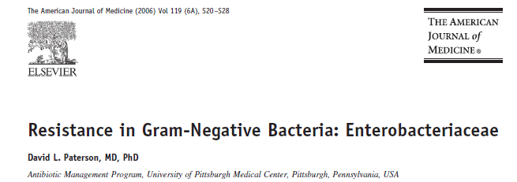

Slide 33
Another Beta Lactamase: Extended Spectrum Beta Lactamases (ESBL)
Plasmid mediated
Linked with other resistance genes
Derived from “broad spectrum” older beta lactamases known for years such as TEM, SHV, OSA
Substrates (meaning drugs that enzyme destroys) include all penicillins, 1st-3rd generation cephalosporins but not cephamycins (cefoxitin/cefotetan) and carbapenems
Inhibited by beta lactamase inhibitors, but PARADOX 2
Pip/tazo and others may not be clinically effective
Probably because of other plasmid mediated resistance mechanisms such as Amp C plus porin changes
Treatment of choice was CARBAPENEMS
Now, ceftolazone/tazo and ceftaz/avi have some activity

Slide 34
The Last Line of Defense
Fortunately, our most potent β-lactam class, carbapenems, remained effective against almost all Enterobacteriaceae.
Doripenem, Ertapenem, Imipenem, Meropenem
Unfortunately, “Antimicrobial resistance follows antimicrobial use as surely as night follows day”

Slide 35
Carbapenemases in the U.S.
Enzyme | Bacteria
KPC | Enterobacteriaceae
Metallo-β-lactamase | P. aeruginosa
OXA | Acinetobacter spp.
SME | Serratia marcesens

Slide 36
Klebsiella Pneumoniae Carbapenemase
KPC is a class A β-lactamase
Confers resistance to all β-lactams including extended-spectrum cephalosporins and carbapenems
Occurs in Enterobacteriaceae
Most commonly in Klebsiella pneumoniae
Also reported in: K. oxytoca, Citrobacter freundii, Enterobacter spp., Escherichia coli, Salmonella spp., Serratia spp.,
Also reported in Pseudomonas aeruginosa (South America)

Slide 37
A Primer on Beta Lactamases and Newer BLIs Van Duin, Bonomo. Clin Inf Dis 2016; 63 (2):234-241

Slide 38
New Delhi Metalloproteinases (NDM-1):
As if we didn’t have enough to worry about!

Slide 39
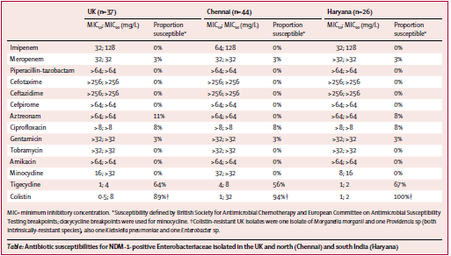

Slide 40
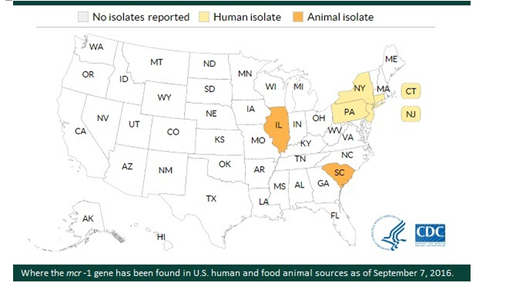
And, As If That Wasn’t Enough: Colistin Resistance!

Slide 41
Resistance Summary
Resistance to most antibiotics is inevitable
Mitigate the damage by
Enforcing Infection Prevention measures
Hand Hygiene
Contact Isolation when appropriate
Gowns and gloves for patients with MDR organisms
Antibiotic Stewardship
Less broad spectrum
Shorter duration
Continued research into new mechanisms of antibiotics
Incentives to PHARM for new drug development
Extension of patent protection

Slide 42
Everything You Wanted to Know…..

